Slide 1
Data Science Notes Machine Learning
Zizhu Zhang

Slide 2
Ensemble Methods
Averaging Methods
Bagging
Random Forest
Boosting Methods
AdaBoost
GBRT
Build several estimators independently
Average predictions of several estimators
Reduce variance of single estimator
Build several estimators sequentially
Use a weighted majority vote to combine predictions
Reduce bias of the combined estimator in previous steps

Slide 3
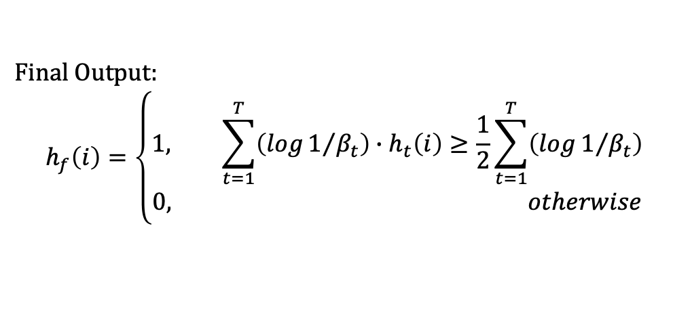

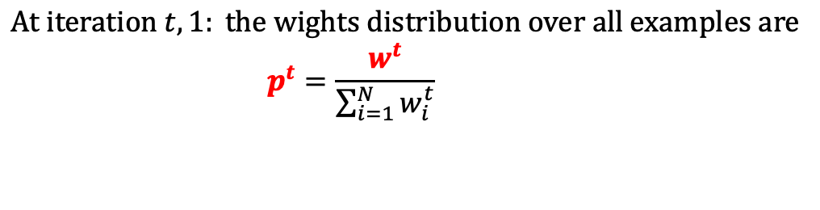
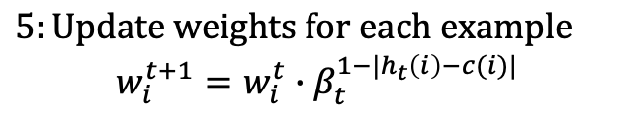

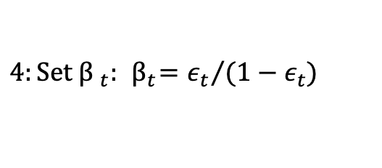

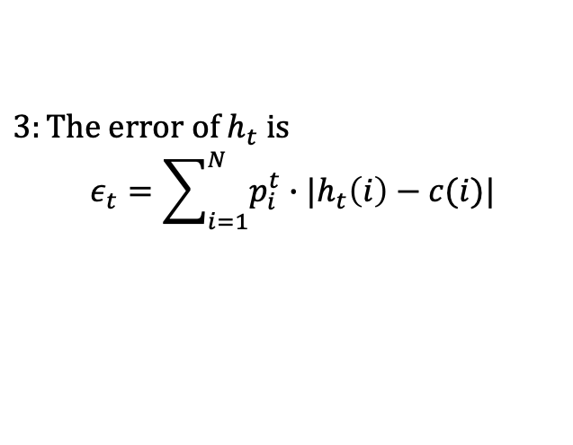

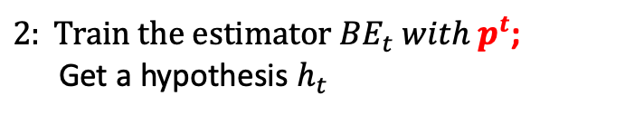

AdaBoost Algorithm
$$A set of N labeled examples \{\left(1,c\left(1\right)\right), \left(2,c\left(2\right)\right),…(N,c\left(N\right))\}$$
Original data
$$At iteration t, 1: the wights distribution over all examples are$$
$$p^{t}=\frac{w^{t}}{\sum_{i=1}^{N}{w_{i}^{t}}}$$
Base Estimator 1
$2: Train the estimator {BE}_{t} with p^{t}$;
Get a hypothesis $h_{t}$
Hit
Missed
Final
Estimator
=
Weighted average of the T estimators
$3:The error of h_{t} is$
$$ε_{t}=\sum_{i=1}^{N}{p_{i}^{t}∙|h_{t}\left(i\right)−c(i)|}$$
$$ε_{t}∈[0,½)$$
Decreased weights
Increased weights
$$4:Set {β }_{t}: { β}_{t}={ε_{t}}/{(1−ε_{t})}$$
$$ε_{t}↑,{β }_{t}↑$$
Base Estimator 2
$$5:Update weights for each example$$
$$w_{i}^{t+1}=w_{i}^{t}∙β_{t}^{1−|h_{t}\left(i\right)−c(i)|}$$
$$\left|h_{t}\left(i\right)−c\left(i\right)\right|↑$$
Hit
Missed
$β_{t}^{1−|h_{t}\left(i\right)−c(i)|} ↑$
Decreased weights
Increased weights
… …
Final Output:
$$h_{f}\left(i\right)=\left\{\begin{aligned}1, \sum_{t=1}^{T}{\left(log1/{β_{t}}\right)∙h_{t}\left(i\right)}≥\frac{1}{2}\sum_{t=1}^{T}{\left(log1/{β_{t}}\right)} \\ 0, otherwise\end{aligned}\right.$$
$${β }_{t}↑, ↓to the final$$
Base estimator T
Hit
Missed

Slide 4


AdaBoost Process
Original data
Original data
Base Estimator 1
Base Estimator 1
Hit
Missed
Hit
Missed
Final
Estimator
=
Weighted average of the T estimators
Decreased weights
Increased weights
Decreased weights
Increased weights
BE1 +
Base Estimator 2
Base Estimator 2
Hit
Missed
Hit
Missed
Decreased weights
Increased weights
Decreased weights
Increased weights
… …
… …
BE1…T-1
Base estimator T
Base estimator T
Hit
Missed
Hit
Missed

Slide 5
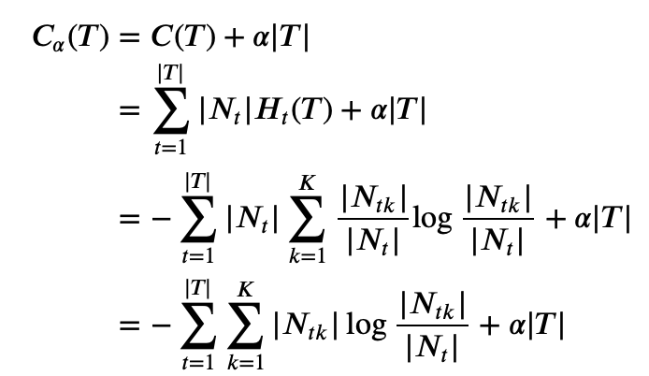







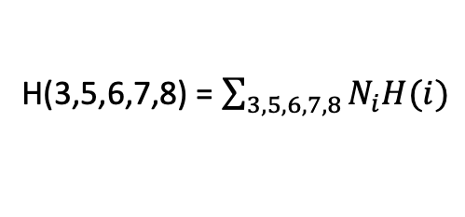



Pruning
年龄
青年
老年
中年
学生
买
信誉
H(3,5,6,7,8) = $\sum_{3,5,6,7,8}{N_{i}H(i)}$
否
是
叶子
优
良
不买
买
买/不买
买
不买
买
买
叶子
叶子
叶子
叶子

